Slide 1
Prediction Challenge #2
Ali Awari

Slide 2
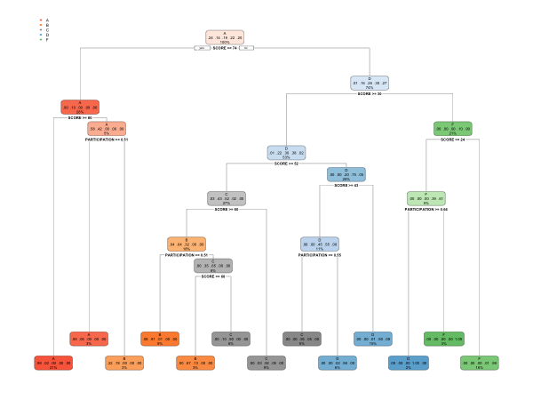
What my tree looks like.
A higher percentage of predictability comes from scores and participation, which make up a majority of the tree.

Slide 3
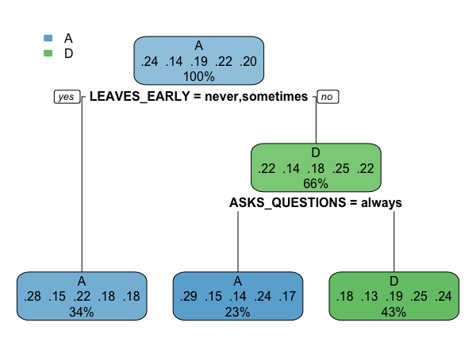
A different tree
Examining different trees, by excluding participation and score led me to find a pattern less significant pattern based around “Leaving Early” and “Asks Questions”.

Slide 4
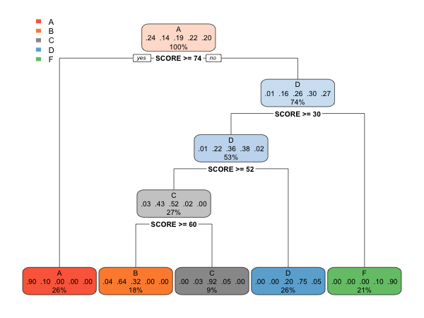
Score Tree
Seeing how you can use scores to predict the tree also might give some insight into how well our model will predict the final test set.

Slide 5
Error Rate
accuracy_subset accuracy_all
1 0.8154762 0.8750000
2 0.8154762 0.9107143
The accuracy rates I receive are lower than my previous attempts at predicting the dataset, so I may submit my old data as well.

Slide 6
Conclusion
Using a decision tree will unmask multiple hidden patterns given there exists one if the current setup of data. It allows researchers to quickly analyze data and test hypothesis’s on data.
Decision trees cannot see patterns that have to do with manipulating your data and lacks customizability to a certain extent, so using a tree with custom code may give better results.

